Slide 1
BGOV OnPoint Biden’s Economic and Tax Plan
By Bloomberg Government Analysts
April 28, 2021

Slide 2
About This Presentation
President Joe Biden unveiled the second portion of his wide-ranging infrastructure and economic plan on April 28, called the “American Families Plan”
The package totals $1.8 trillion and would include:
Two years of free community college, universal preschool, and child care assistance
National paid family and medical leave
Expanded nutrition assistance
Extended child, earned income, and dependent care tax credits
Plan would raise taxes on wealthy households, saving about $1.5 trillion over a decade
Increases top income and capital gains tax rates to 39.6%
Ends tax breaks related to inheritance and investment funds
Increases support for IRS tax enforcement
To contact the editor responsible: Adam Schank at aschank@bgov.com

Slide 3
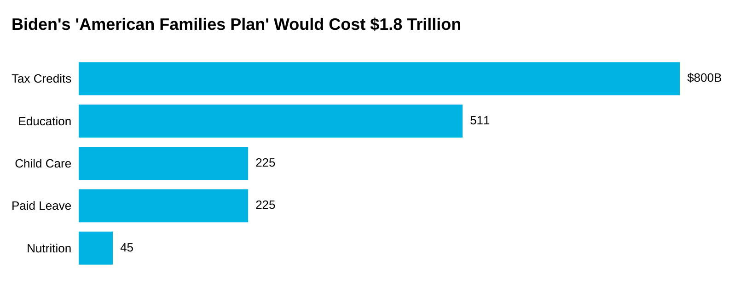
Funds Provided for Education, Child Care, and More
Notes: Education funding includes universal preschool, free community college, Pell Grant increases, and teacher investments. Tax credits include the child tax credit, earned income tax credit, child and dependent care tax credit, and Affordable Care Act premium tax credit.
Source: White House fact sheet

Slide 4
Tax Increases on Wealthy Would Raise $1.5 Trillion Over Decade
Plan would be funded by several tax changes to individual income, including:
Raising the top marginal income tax rate to 39.6% from 37% for the top 1% of earners
Increasing the capital gains tax rate to 39.6% for households earning $1 million or more
Applying the 3.8% Medicare tax “consistently” for those making over $400,000
Repealing “step-up in basis” rule, which effectively reduces taxes owed on wealth passed to an heir
Would exempt the first $1 million in gains from the repeal, ensure gains are taxed if they aren’t used for charitable donations, and provide protections for family-owned businesses and farms
It also would:
Eliminate carried interest so investment fund partners pay ordinary income rates
End a real estate tax break when investors exchange property for gains above $500,000
Permanently extend current limits on excess business losses
Increase IRS audits for higher-income individuals and require financial institutions to report on earnings from investments and business activity

Slide 5
Tax Credits for Families, Workers Would Total $800 Billion
Biden’s plan would extend through 2025 the child tax credit expansions enacted under Public Law 117-2
Would advance credits on a regular basis and permanently make it fully refundable, meaning the entire credit could be provided as a refund if it exceeds an individual’s tax liability
Proposal would call on Congress to permanently extend other tax credits, including:
Earned income credit for childless workers, which was tripled under Public Law 117-2
Child and dependent care credit, which Public Law 117-2 increased to as much as $4,000 for one dependent and $8,000 for two or more
It would make permanent expansions to the Affordable Care Act’s premium tax credits, which would cost $200 billion
Health insurance premiums were lowered for two years under Public Law 117-2 for those who purchase coverage through an exchange

Slide 6
Plan Targets Aid for Low-Income College Students
The plan calls for resources to increase community college and university attendance:
$109 billion to provide two years of free community college to all Americans, including “Dreamers”
“Dreamers” refers to children brought to the U.S. illegally who would have been covered by the DREAM Act
$85 billion to increase Pell Grants by around $1,400 per recipient
$62 billion for grants to increase retention and completion rates at community colleges and other institutions serving disadvantaged communities
It also calls for $46 billion for historically Black colleges and universities (HBCUs), tribal colleges and universities (TCUs), and minority-serving institutions (MSIs)
Includes $39 billion in tuition assistance for families earning less than $125,000 per year
Would be in addition to $45 billion for HBCUs, TCUs, and MSIs under Biden’s American Jobs Plan
Note: DREAM Act - Development, Relief, and Education for Alien Minors Act, a proposal to grant legal status and a path to citizenship for those living in the U.S. illegally after being brought to the country as children that’s been incorporated into H.R. 6 (See BGOV Bill Summary) among other measures

Slide 7
Plan Includes $9 Billion to Support Teachers
Biden seeks funds to address teacher shortages, improve training, and boost diversity
Plan cites estimated shortage of more than 100,000 teachers before the pandemic
The proposal would include:
$2.8 billion for Grow Your Own programs and paid teacher residencies
$2 billion for mentorship programs for teachers
$1.6 billion for teachers to get certified in high-demand areas
$900 million to develop special education teachers
$400 million for teacher preparation programs at historically Black colleges and universities, tribal colleges and universities, and minority-serving institutions
Scholarships of $8,000 per year, instead of $4,000, for future teachers pursuing their degrees

Slide 8
Plan Would Provide Free Preschool and Affordable Child Care
$200 billion would go to providing free preschool to all 3- and 4-year-olds
Plan would be in partnership with states, focusing on high-need areas and quality, inclusive programs
$15 per hour minimum wage for employees in participating preschool and Head Start programs
5 million children would benefit from access to publicly funded preschool, plan says
$225 billion would provide direct support to help working families with child care costs
Families earning the least would pay nothing and those earning 1.5 times the state median would pay no more than 7% of their income for child care for children younger than five
Child care providers would receive funding to cover the “true cost” of providing child care
$15 per hour minimum wage for early childhood staff
Community college and teacher scholarship investments would also support early childhood educators

Slide 9
Biden Would Boost Funding For Some Nutrition Programs
Plan calls for additional funding for school-related nutrition programs
$25 billion to expand the Summer Pandemic Electronic Benefit Transfer (EBT) demonstration program to all eligible children and make it permanent
$17 billion to expand free school meals for elementary-age children in high-poverty school districts
$1 billion for a demonstration program to promote school meals that exceed nutrition standards
It also would make individuals convicted of drug offenses eligible for SNAP after their incarceration
Note: SNAP – Supplemental Nutrition Assistance Program, formerly food stamps

Slide 10
Plan Would Support Paid Family and Sick Leave
Plan would create a national paid family and medical leave program, which would cost $225 billion over 10 years
Leave could be used for a new child; serious personal or family illness; bereavement; circumstances related to sexual assault, stalking, or domestic violence; or family member’s military deployment
Would guarantee 12 weeks of paid leave by the tenth year of the program, and three days for bereavement annually to begin in the first year
Would provide as much as $4,000 monthly, with at least two-thirds of average weekly wages replaced
Increases to 80% wage replacement for low-wage workers
Proposal calls on Congress to pass the “Healthy Families Act” (H.R. 2465, S. 1195)
Would require certain employers to allow workers to accrue seven days of paid sick leave annually

Slide 11
Biden Previews Other Priorities
Plan doesn’t directly address health-care policies, says Biden “has a plan” to:
Lower drug costs by letting Medicare negotiate prices
Create a public health-care option
Lower the Medicare eligibility age to 60
Close the Medicaid “coverage gap” in states that didn’t expand the program
Proposal says Biden wants to work with Congress to automatically adjust unemployment benefits based on economic conditions
Doesn’t address pandemic jobless benefits that expire Sept. 6

Slide 12
About Bloomberg Government

